Slide 1

Online Retail Store Data Warehouse
Kaitav Mehta

Slide 2

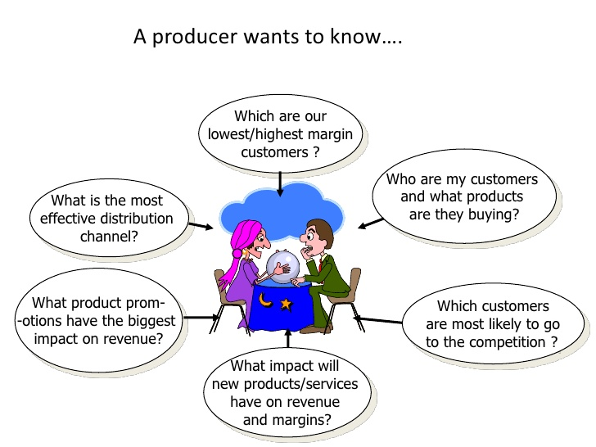

Online Retail Store Data Warehouse
There are two online retail store of producer namely Costco and Wallmart.
To answer these queries this system will integrate these two stores data source into a data warehouse.

Slide 3
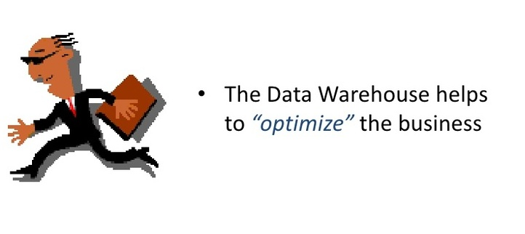

Project Importance
With this project producer can find and use strategies like Trend analysis, Buying pattern analysis, Pricing policy, Inventory control, Sales promotions to increase the profit of the business and win over peer competition.

Slide 4
Work Involved
Designing the source data base of both the stores in 3NF. And creating an interactive view to insert the data into these data source.
Designing and creating data warehouse, this DW consist of the main integrated net sales as measure aggregate and historical table called fact table and to describe fk in fact table, there are dimension tables added.
A Custom ETL, which will convert the data from the source database to a uniform platform where the data warehouse are stored.
Further to answer various queries which can’t be answered by OLTP, OLAP queries are involved in the system and a view page is also created to see the results of these Roll-up, Drill-down, Pivot, Slicing and Dicing OLAP queries.

Slide 5

New Things Learnt
Strategic use of data warehouse to optimize business sales by using various analysis and different views generated by OLAP queries.
Integrating more than one data source into a single system and with those integrated data source creating a custom ETL tool to populate data into data warehouse.

Slide 6
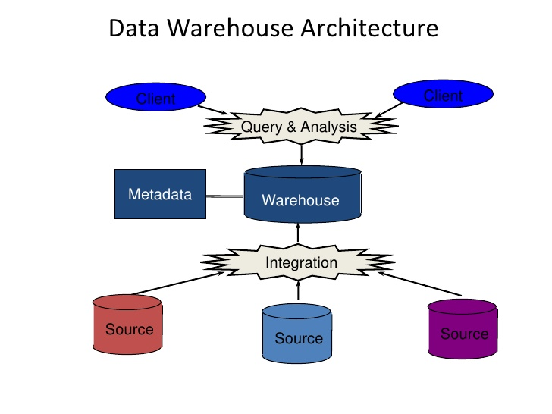
System Design
Source db: costco and wallmart
Custom ETL tool: Implemented in java, which fetches data from both the source db and converts the format of data into DW format and integrates data into fact and dimension tables.

Slide 7
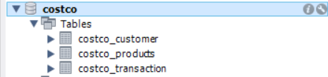
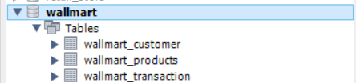
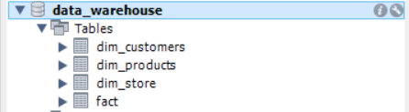
Schema Design

Slide 8
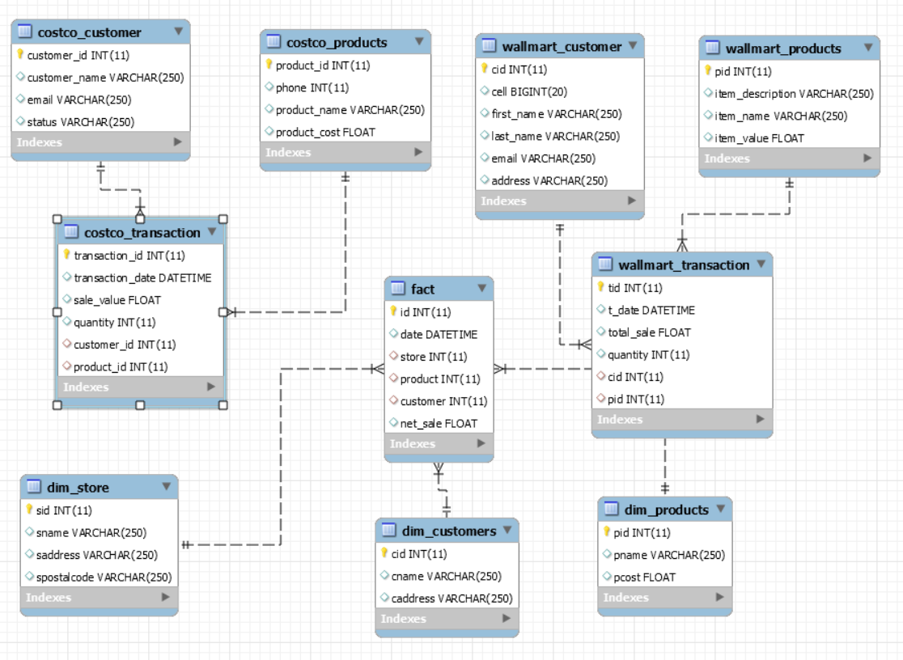
ER-Diagram

Slide 9
Parts of project completed
Design of source database and populating data from the view.
Creating a data warehouse design i.e creating a fact table and associated dimension tables.
Created a custom ETL tool to clean and transform data into the data ware house.

Slide 10
Parts left to complete
Integrating all the three data base into one system to perform ETL tool operations.
01
Adding OLAP queries to view powerful visualization and paradigm and provide good analysis results.
02

